Slide 1

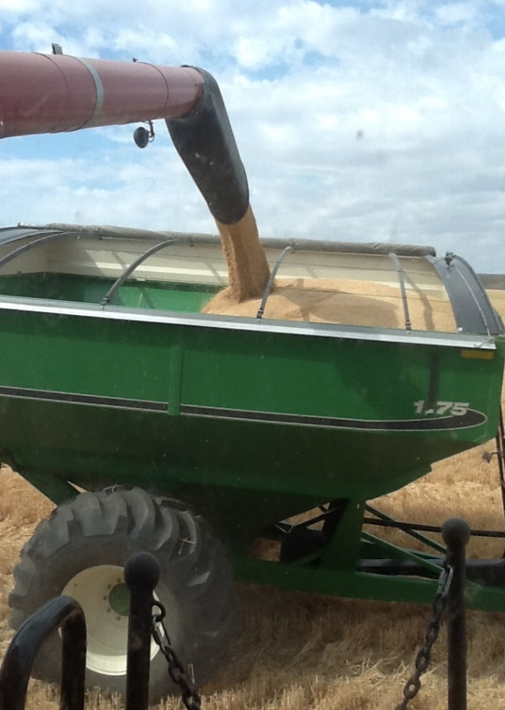
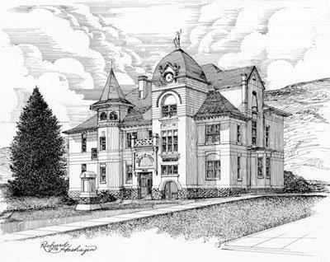
Garfield County Voluntary Stewardship Program
Stewardship Cost-Share Sign-Up for Implementation Projects
The Garfield County Work Group is taking project applications for the following type of projects identified in Garfield VSP Work Plan:
Residue and Tillage Management – No till/Direct Seed/2-Pass
Precision Agriculture – guidance system, auto steer, auto boom, mapping, imagery, etc.
Residue Mowing – with no burning or bailing, residue remains on field
Pest and Nutrient Management
Grazing Management – cross-fence, riparian fence, wells, water developments, pipeline, stock tanks and range plantings
Cover Crop, Pasture and Hay Land Plantings
Conservation Buffers – alfalfa or grass along water ways
Noxious Weed Control on Rangelands – in cooperation with County Weed Board
Wetlands, Tree/Shrub and Critical Area Plantings and Conservation Cover
Please stop by the Pomeroy CD or visit Garfield County VSP website www.garfieldcountyvsp.com for the cost-share rates and applications. Applications are due to the CD by 5:00 pm on Dec 3, 2024 and approved projects need to be completed by June 1, 2025. Please consider filling out our action map here, https://garfieldcountyvsp.mapseed.org/page/about
Garfield County received funding from Washington State Conservation Commission to complete a Plan to protect and/or
restore critical areas while maintaining the viability of AG. June of 2018 Work Plan was approved and is on the VSP website.
Pomeroy Conservation District
910 Main Street
Pomeroy, WA 99347
(509) 843-5008
Garfield County VSP

